Slide 1
Problem
Americans spend $130 billion a year on standby power devices
$450 is wasted each year in electricity costs by every household in the United States
Electricity waste is set to double by 2025 without proper steps taken
Notes:
Energy Efficiency is crucial in meeting our environmental goals and battling global warming.

Slide 2



Solution
Turn-Off
Reduce Usage of Stand-by Devices
Community
Encourage Sharing of Energy
Recommend
Promote Energy Saving Strategies

Slide 3


Slide 4

Who We Are

Slide 5
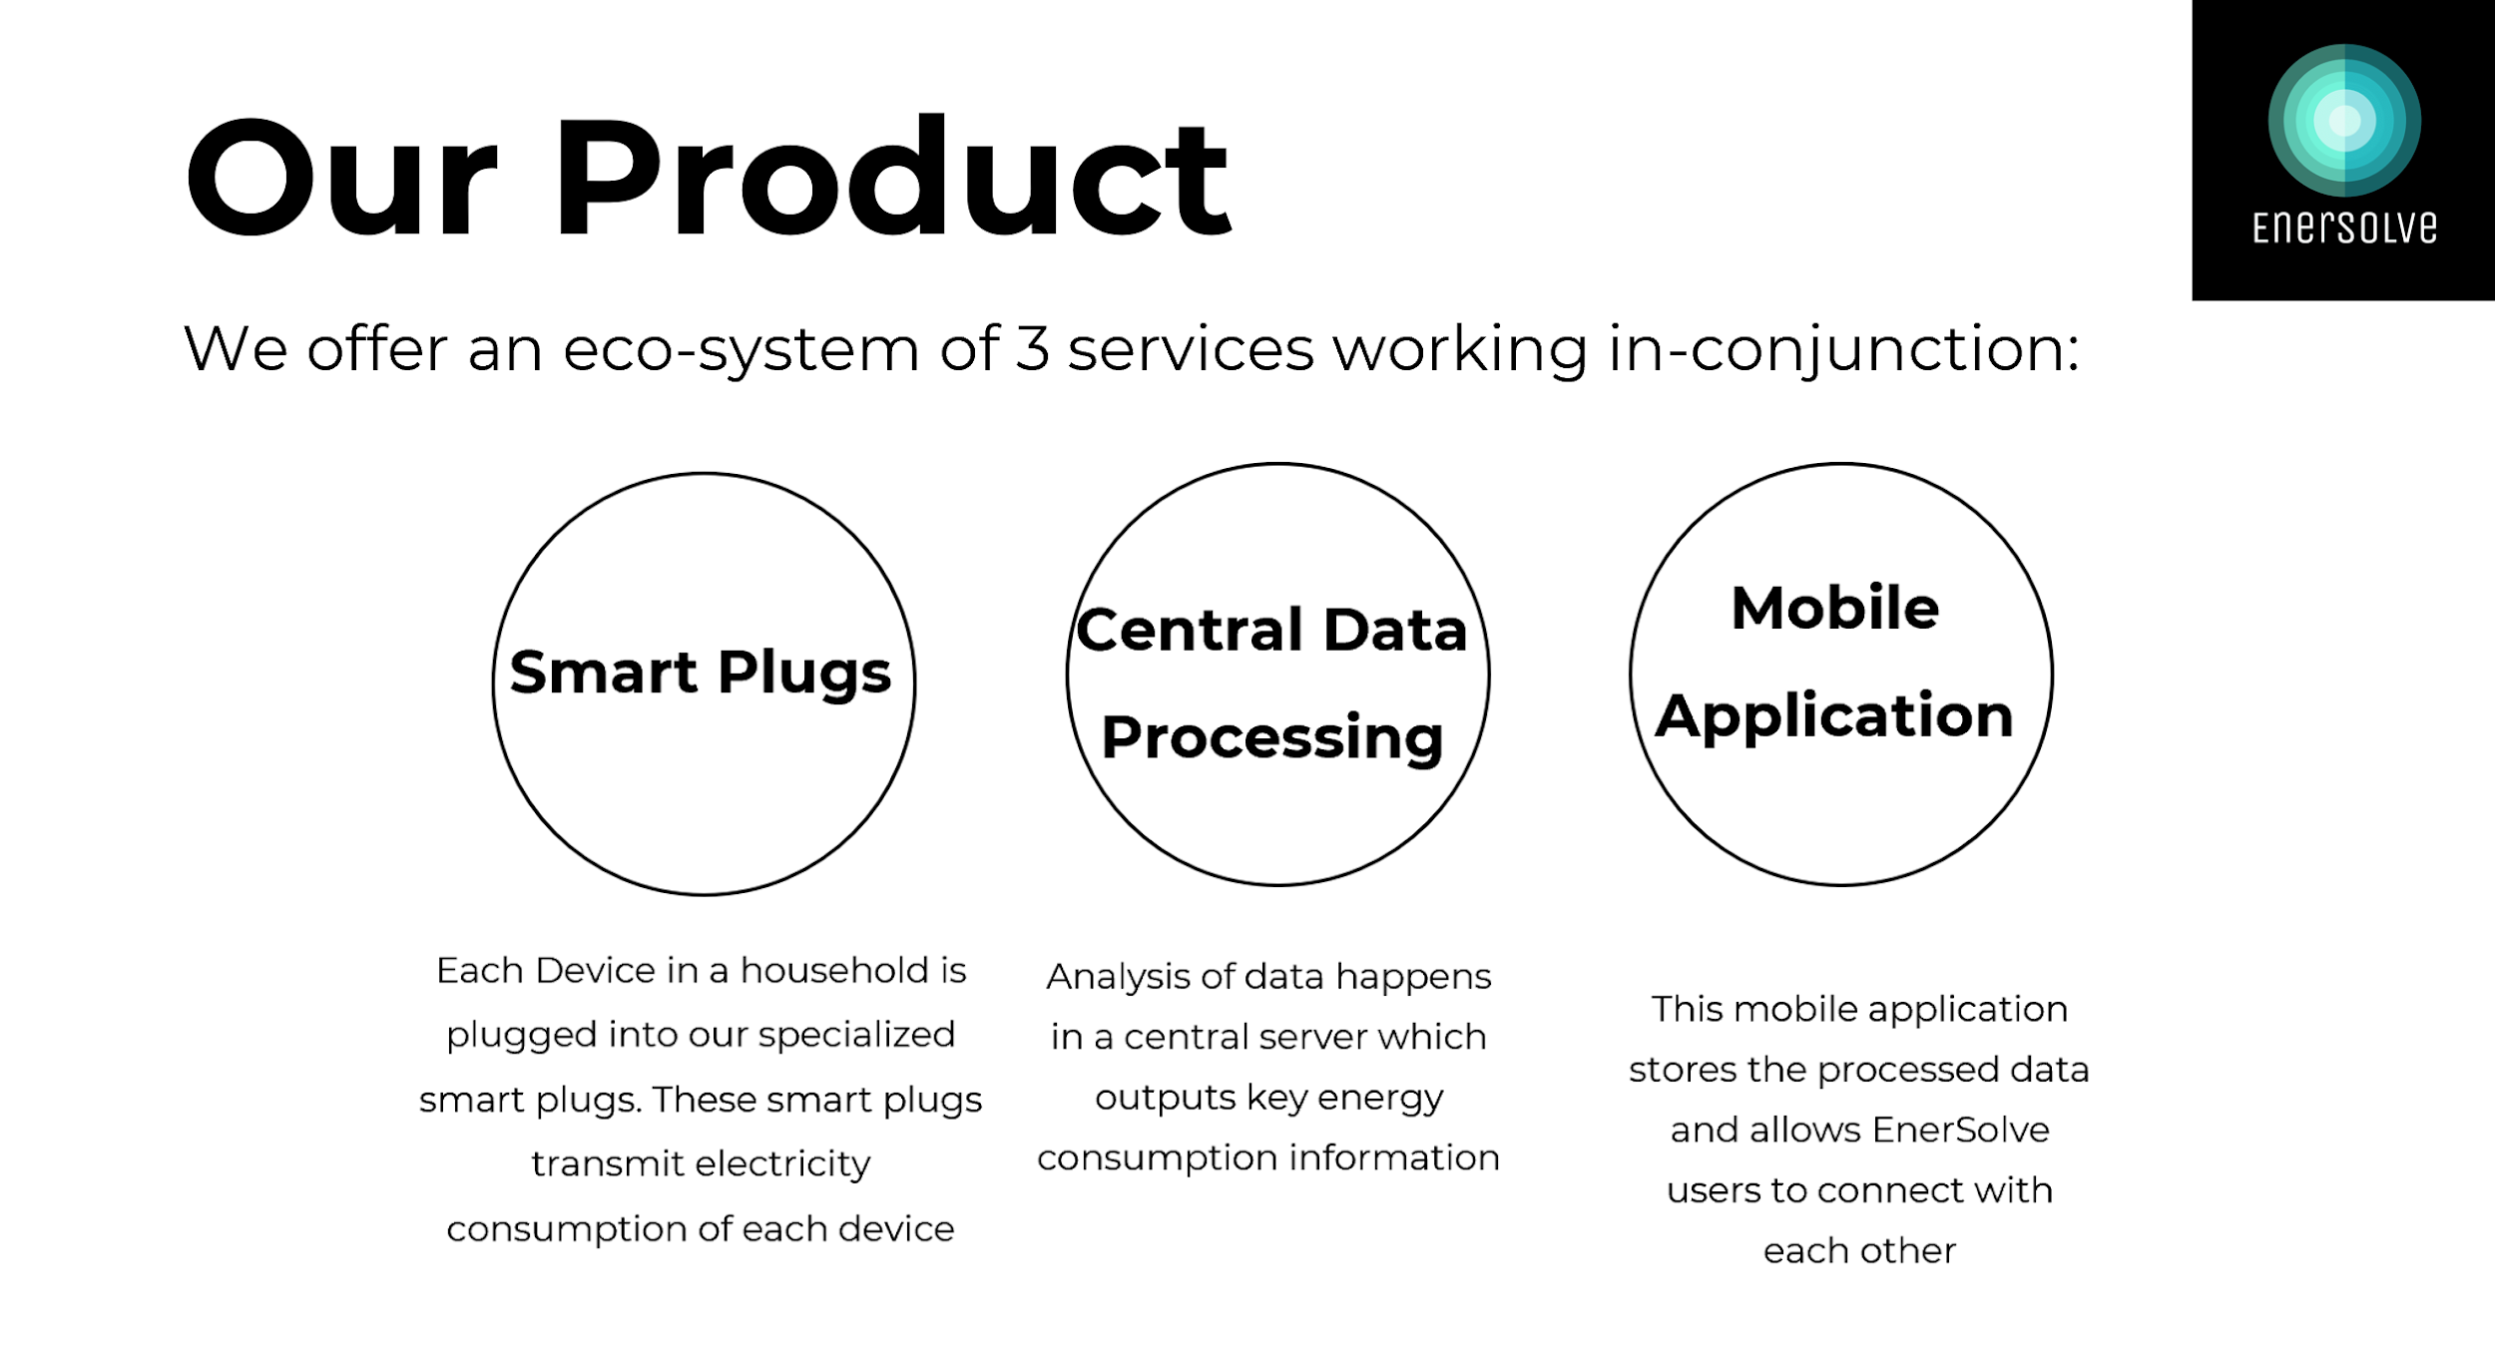
EnerConnect
Allows incentivized pooling of resources within communities

Slide 6

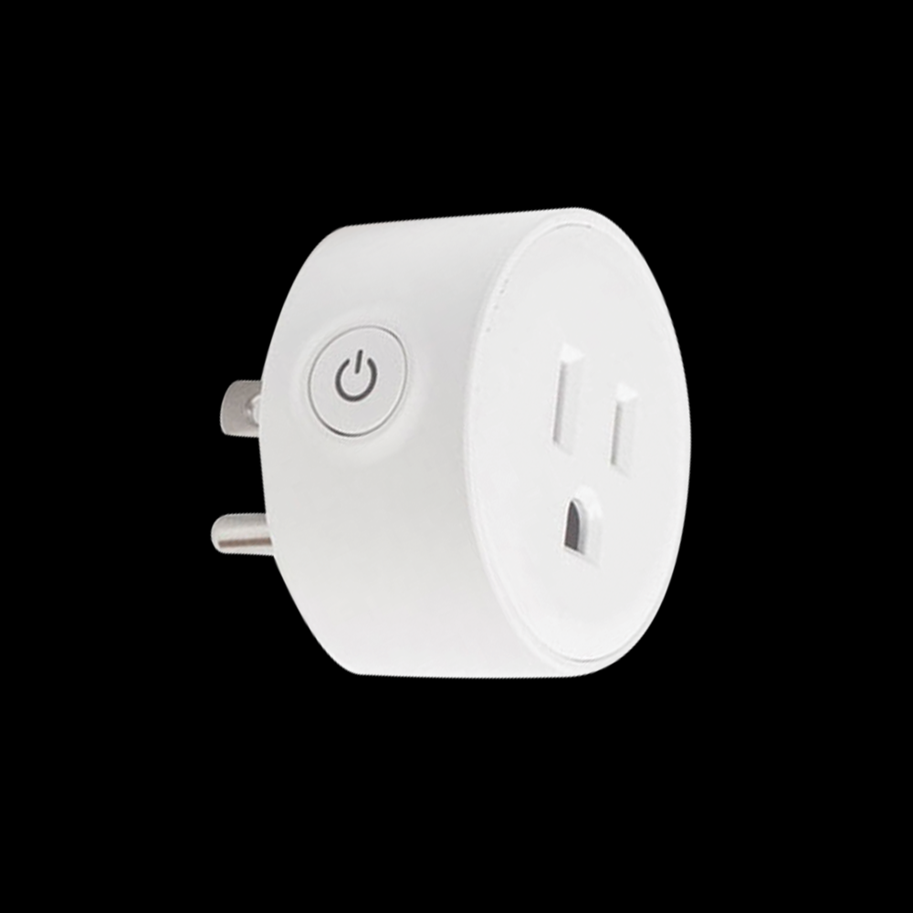
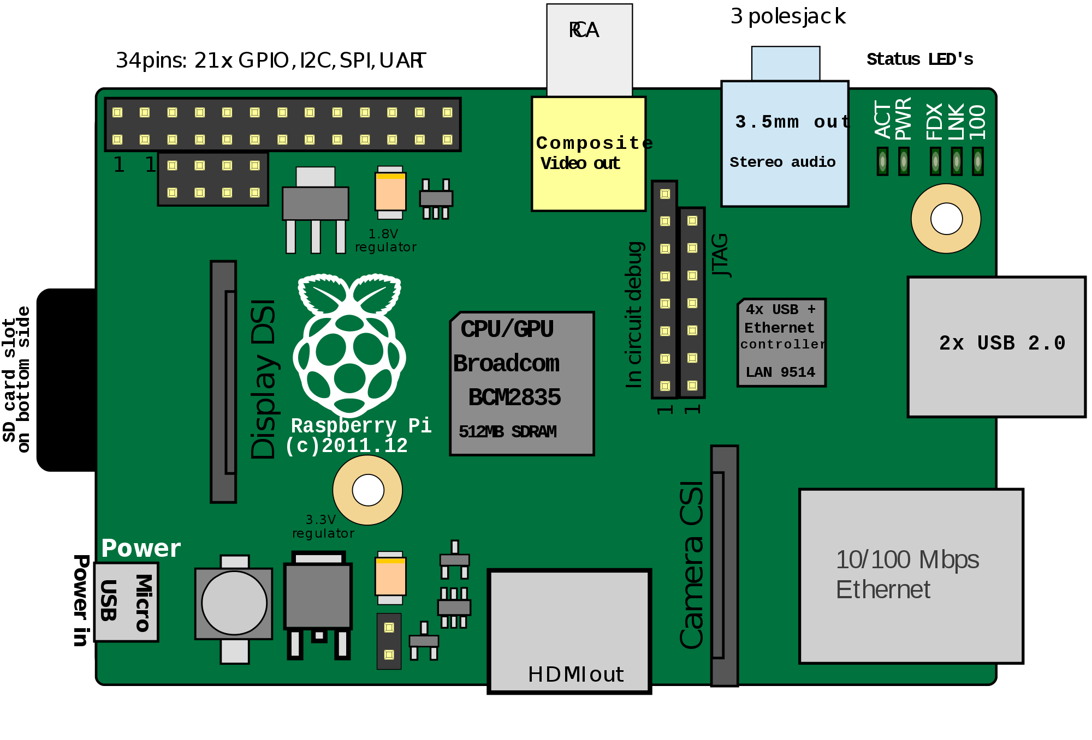

Data Output
Amazon ECHO
How it Works
CSV Files
Mobile Phone Application
Data Collection
Smart Plugs collect data on the name and power consumption of each device plugged into smart plug
Data Processing
Parses data based on devices on and devices with most consumption
Identifies maximum consumption
Identifies possible tips to save

Slide 7





A little bit of sharing...
Notes:
Energy Efficiency is crucial in meeting our environmental goals and battling global warming.

Slide 8
Business Model
A monthly subscription charge for the application on the app-store
Price of $9.00
Smart plug sold separately
Retail Price of $24.99
Incentives
If you host 3 meetups or more, $5.00 discount per month

Slide 9
Flexibility
Our application works directly with Amazon Alexa to output means by which users can save electricity
Future - Additional devices can be added to work with our platform
Notes:
Energy Efficiency is crucial in meeting our environmental goals and battling global warming.

Slide 10
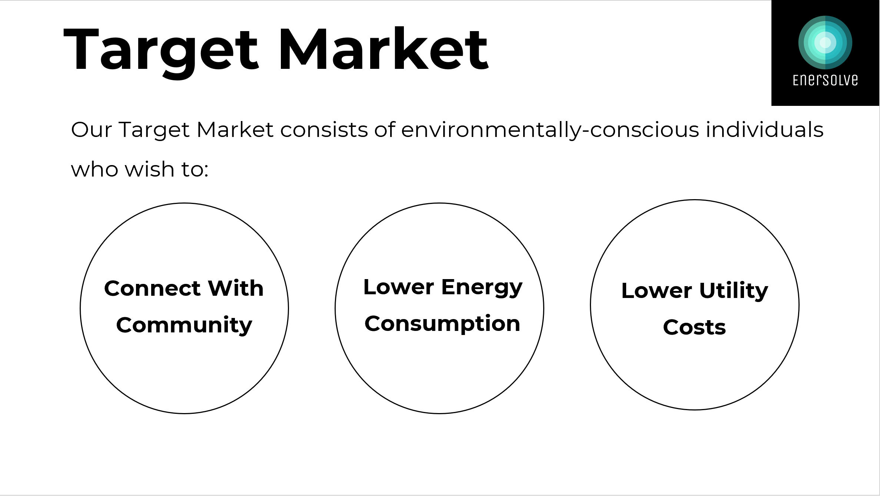



Target Market
Our Target client consists of Energy companies across Canada and the United States
EnerConnect
Allows incentivized pooling of resources within communities

Slide 11
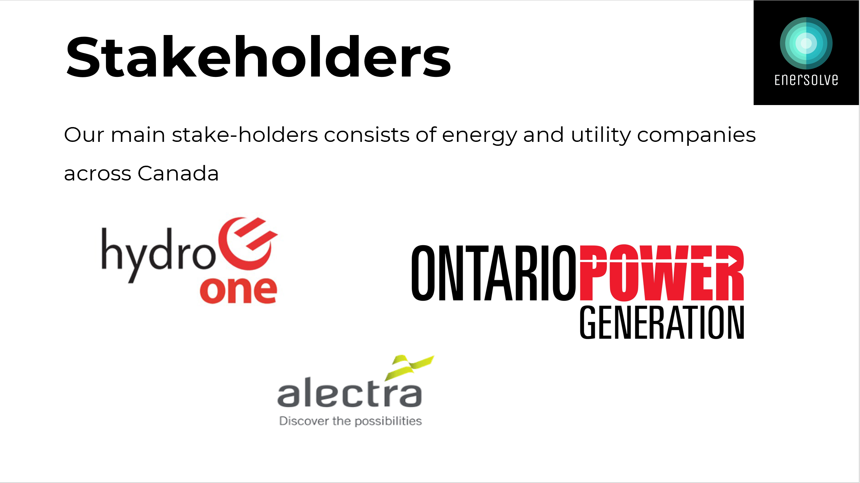
Target Market
Our Target client consists of Energy companies across Canada and the United States
EnerConnect
Allows incentivized pooling of resources within communities

Slide 12
Conclusion
“Fighting Energy Waste in a Simple, Streamlined Process while building meaning connections”
EnerConnect
Allows incentivized pooling of resources within communities

Slide 13
Thank You For Listening!
Any Questions?

